Slide 1
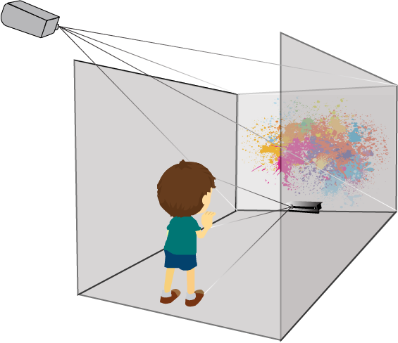
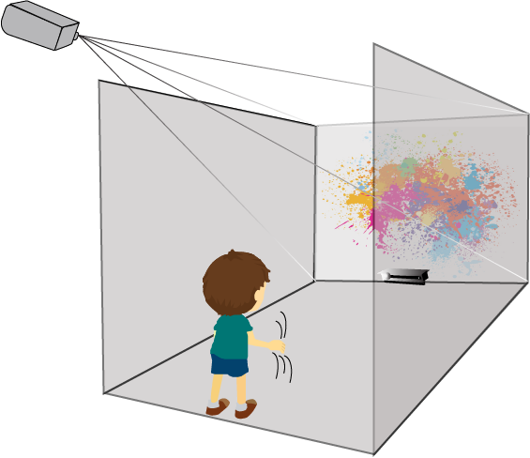



Interactive Digital Art Using Sensor Technology
Katie Griffiths
B.Sc. (Hons) in Computing with Multimedia
Abstract
Sensor technologies involves devices that detect and respond to inputs from a physical environment. The sensor device then converts the physical input into an electrical signal.
Objective
Providing an alternative way for children on the Autistic spectrum to paint freely and expressively with the movement of their hands.
Methods
A non-virtual Computer Aided Visual Environment (CAVE), was used to facilitate the child to develop “artwork” in a creative, fun and educational way. Unity was used to build the front end GUI and materials, the development of gestures was created using Visual Studio IDE in C#. The user’s hand movements were tracked using the Kinect V2.
Abstract
Sensor technologies involves devices that detect and respond to inputs from a physical environment. The sensor device then converts the physical input into an electrical signal.
Objective
Providing an alternative way for children on the Autistic spectrum to paint freely and expressively with the movement of their hands.
Methods
A non-virtual Computer Aided Visual Environment (CAVE), was used to facilitate the child to develop “artwork” in a creative, fun and educational way. Unity was used to build the front end GUI and materials, the development of gestures was created using Visual Studio IDE in C#. The user’s hand movements were tracked using the Kinect V2.
Results
Conclusions
Success was achieved in detecting the movements and hand gestures of the users using the Kinect V2.
These gestures were then used to produce art work in a free movement environment.
This application can be further developed to enable a wide range of activities in art therapy for children on the Autism spectrum to assist in the continuation of developing the children’s communication and emotional skills.
Notes:
- Change the unity logo version to a better one (check 100% zoom)

